Slide 1

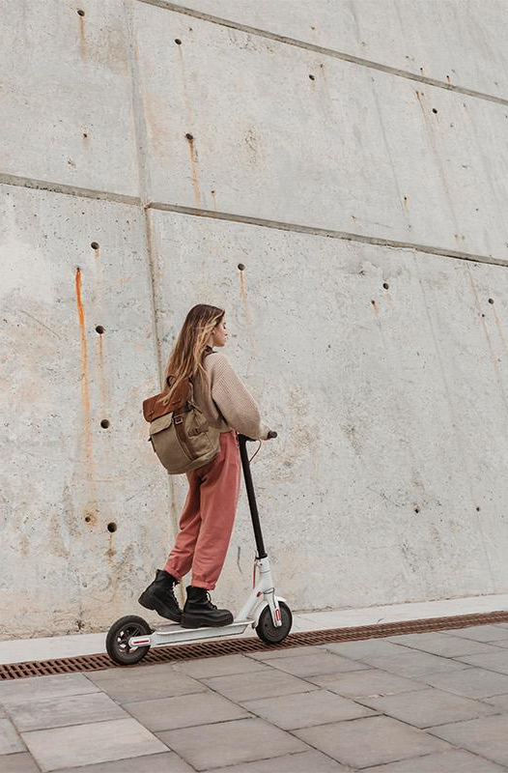
Scooter Usage
Will it Change if Students Use their Transportation fee?
Anum Malik (anumm)
Mohammad Manzoor Mirza (mmmirza)
Elizabeth Root (eroot)
Raja Safiullah (rsafiull)
Hajra Shahab (hshahab)
Alex Talbott (atalbott)

Slide 2
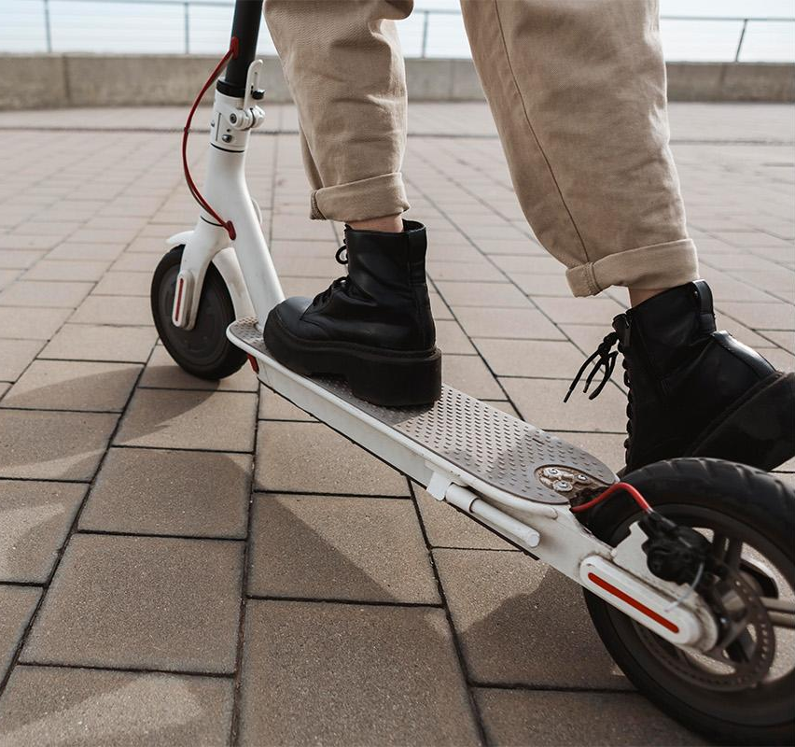
01
Electric Scooters
In Pittsburgh

Slide 3
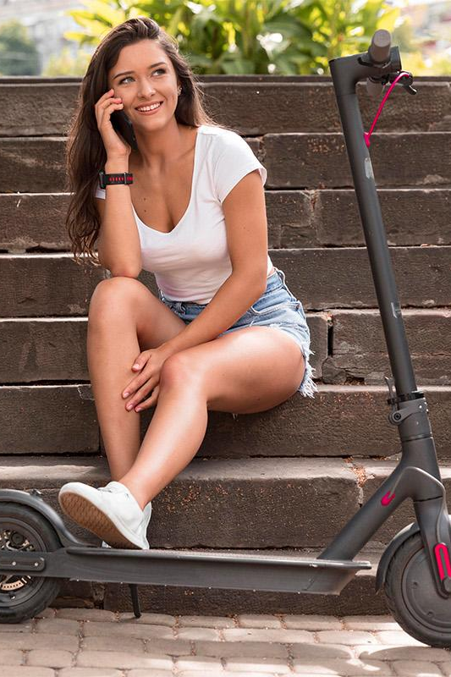
Electric scooters
Available in over 100 US cities¹
Designed to be eco-friendly “last mile solution”
Over forty million trips as of 2018¹

Slide 4
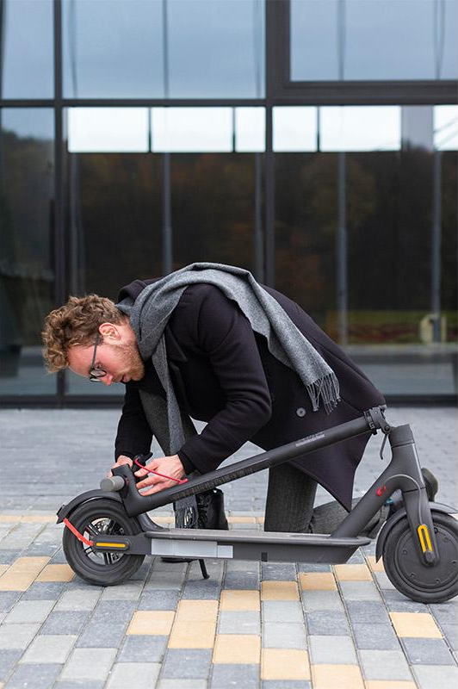
Spin Pittsburgh
Introduced in July 2021
131,444 trips as of September 2021²
Subsidies for low-income individuals
$1 for first minute, $0.39 for every minute after
Limited to 15mph

Slide 5
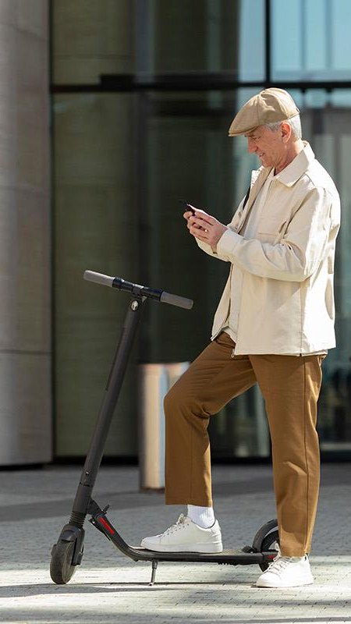
Transportation @ CMU
10-15 minutes
$7-$10
$120
Time most students spend traveling to campus
Estimate of Spin scooter trip to campus
Student transportation fee at CMU

Slide 6
02
Research Question and Experiment

Slide 7
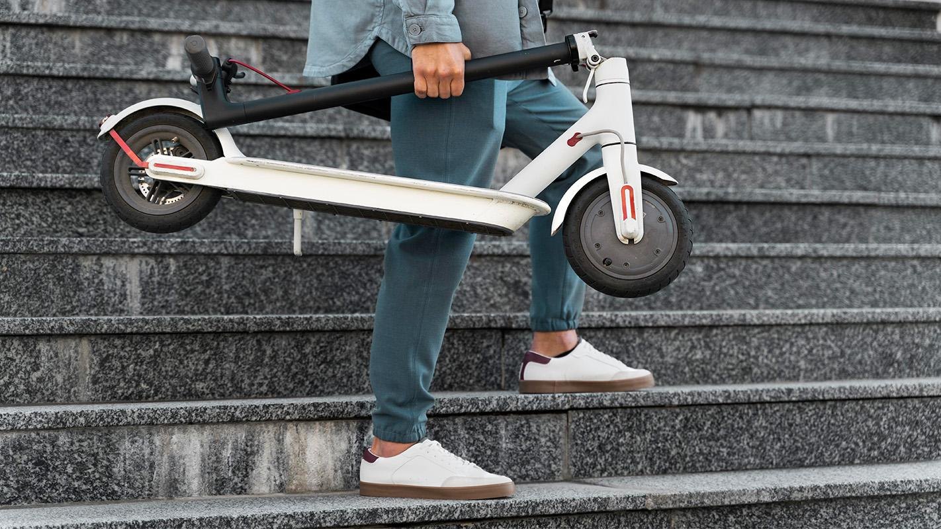
Will students increase the use of electric scooters if unlimited rides are included in their transportation fee?

Slide 8
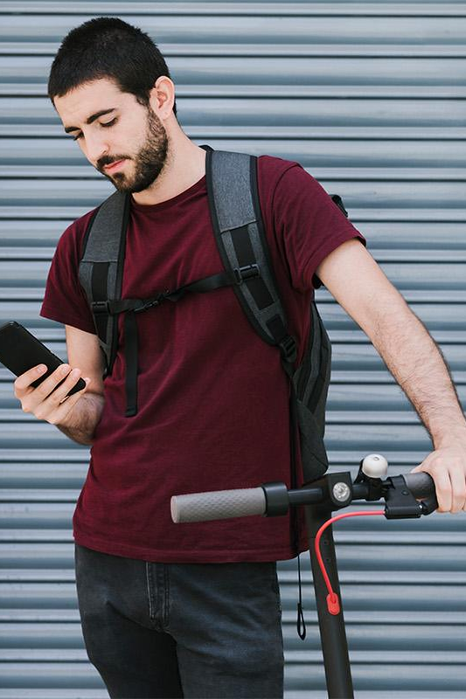
Research Design
Null Hypothesis: there is no difference in the scooter usage between the treatment and control groups.
Randomized Control Trial
Control: No free rides of the scooter on the current student transportation coverage Treatment: Unlimited rides on the student transportation coverage

Slide 9
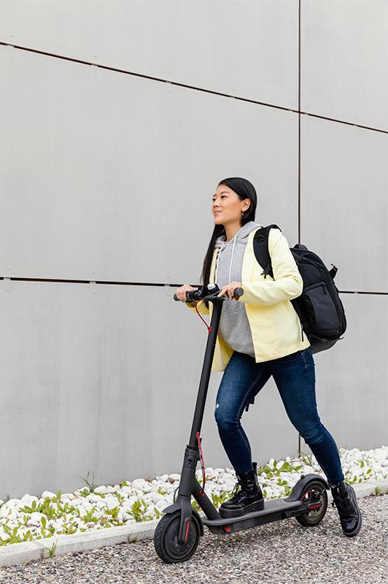
Heterogeneous Effects
We expect Group 2 to exhibit a stronger treatment effect
Group 1: Those living >5 miles from campus
Group 2: Those living <5 miles from campus
—-----------------------------------------
Group 1: Those who consider scooters to be unsafe
Group 2: Those who consider scooters to be safe
—-----------------------------------------
Group 1: Those with annual income <$50k
Group 2: Those with annual income >$50k

Slide 10
03
Data and Analysis

Slide 11
203
Survey Responses*
*Only 201 responses were included in regression analysis

Slide 12
Data facts
91.1%
55.2%
2.00
Familiar with scooters
Have ridden a scooter
Weekly usage (on a scale of 0-9)
2.81
1.41
22.9
Average safety rating (1 lowest, 5 highest)
Average distance to campus (miles)
Average age

Slide 13
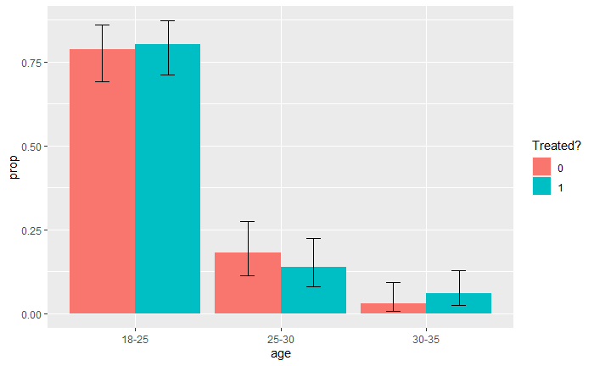
Balance in observables: Age

Slide 14
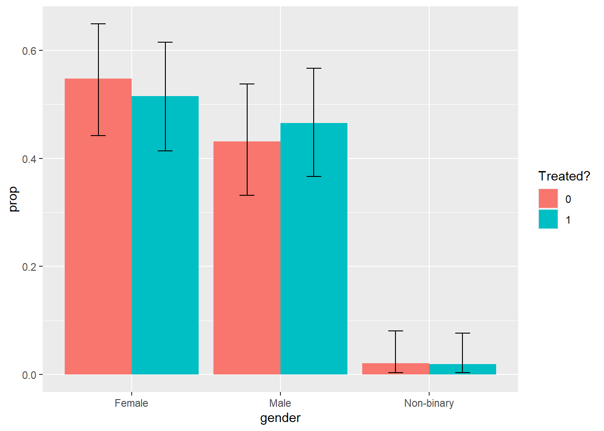
Balance in observables: Gender

Slide 15
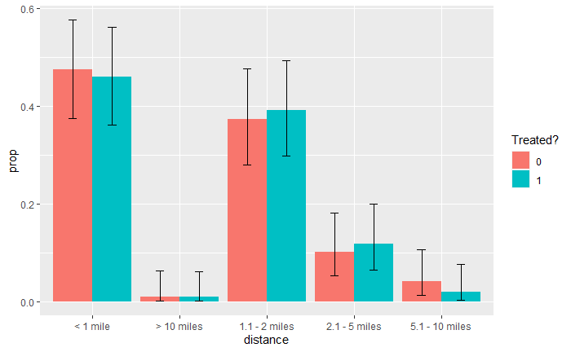
Balance in observables: Distance

Slide 16
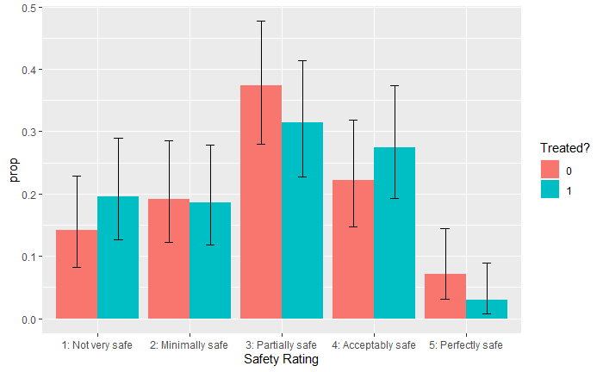
Balance in observables: Safety

Slide 17
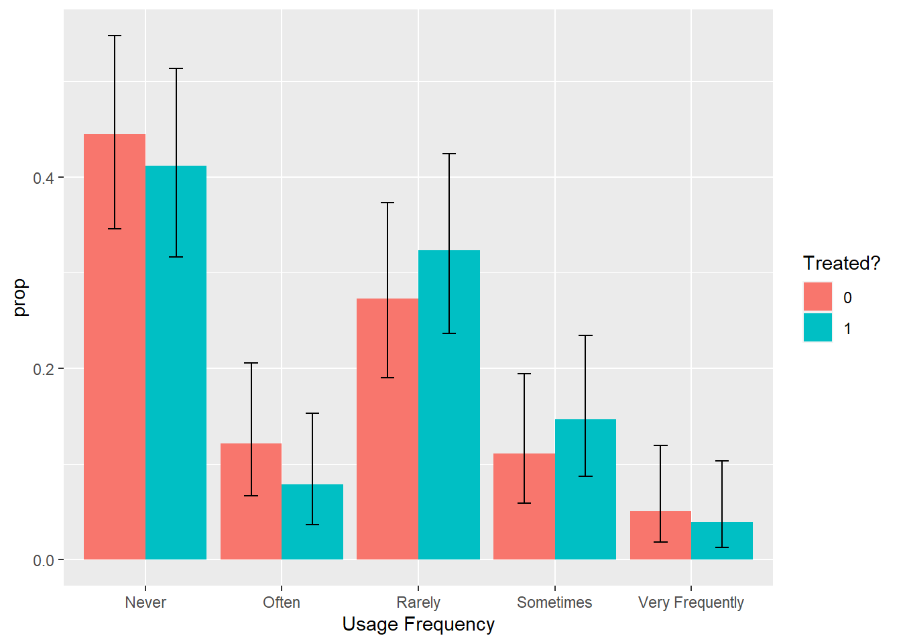
Balance in observables: Freq.

Slide 18
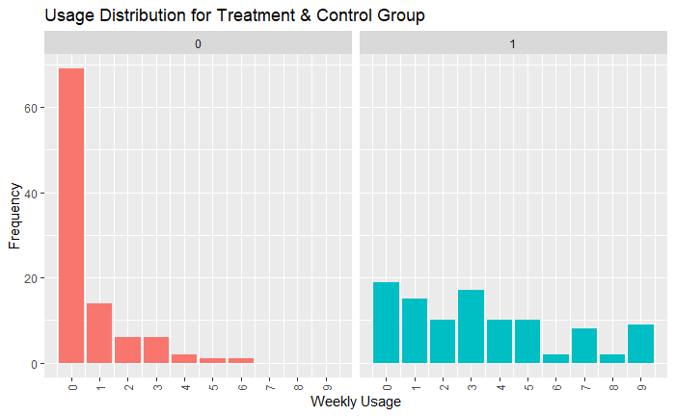
Outcome Distribution: W. Usage
Control
Group
Treatment
Group

Slide 19
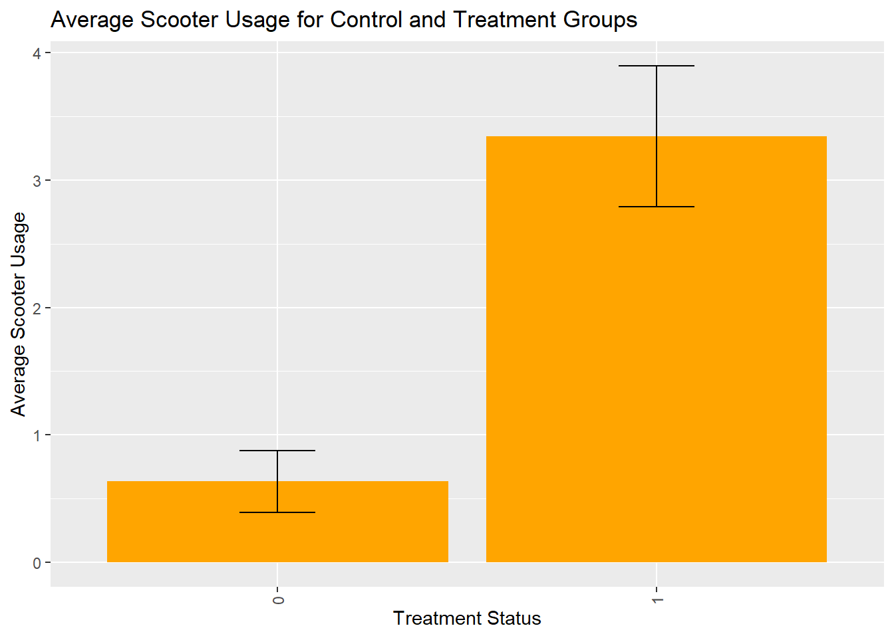
Treatment vs Control: Avg. Usage
Control
Group
Treatment
Group

Slide 20
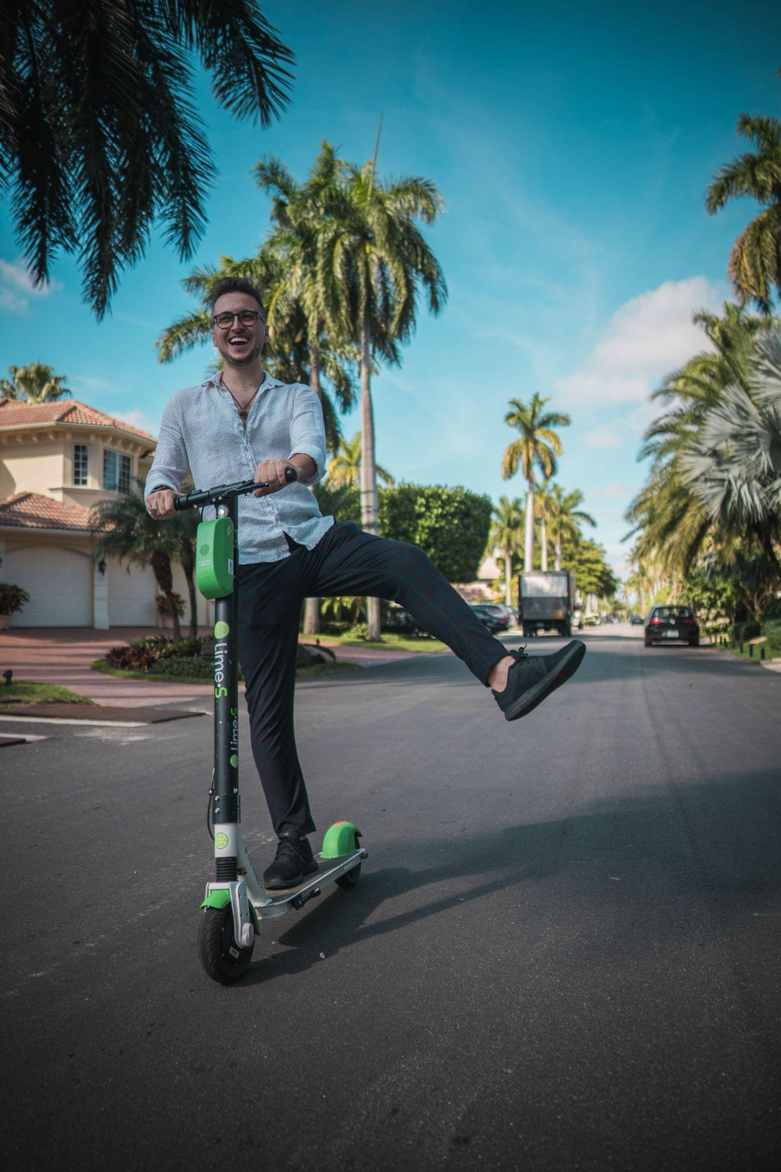
04
Regression

Slide 21
Power Analysis
0.94
Overall Power
0.55
Power for heterogeneous effect (high income)
0.93
Power for heterogeneous effect (near)
0.80
Power for heterogeneous effect (safe)

Slide 22
Checks to confirm randomization
Age Gender Income Familiarity Experience -------------------------------------------------------------------
treated 0.012 0.036 0.164 -0.007 -0.103
Constant 1.242 2.455 5.091 1.919 2.162
-------------------------------------------------------------------
Insight: Regression of these observables against treatment variable does not yield statistically significant coefficients.

Slide 23
Outcome Scooter Usage ~ Treatment
no controls w/ demographic w/ scooter
controls familiarity controls
-------------------------------------------------------------------
treated 2.707*** (0.307) 2.703*** (0.300) 2.609***(0.297)
Constant 0.636*** (0.219) 1.075 (1.136) -0.199 (0.561)
-------------------------------------------------------------------
Insight: Controlling for age, gender, income in the first regression and familiarity & experience in the second regression has no/minimal impact on the treatment variable coefficient.

Slide 24
2+ rides
Causal effect of including scooter rides in transportation fee on weekly scooter usage (on 1-9 scale), significant at 1% level

Slide 25
Heterogeneous Effects
heterogeneous heterogeneous heterogeneous
distance safety income
-------------------------------------------------------------------
treated 0.467 (1.579) 3.180*** (0.371) 2.733***(0.532)
treated:heteroNear 2.298 (1.609)
treated:hetero1Unsafe -1.180* (0.622)
treated:hetero2LowIncome -0.041 (0.653)
Constant 0.200 (0.967) 0.788*** (0.259) 0.656* (0.387)
-------------------------------------------------------------------
Insight: Given the sample size, heterogeneity in the causal effect of interest is observed only between sub-group with different
scooter safety perceptions.

Slide 26
05
Conclusion

Slide 27
Key limitations
Small sample size: Could expand to include all Pittsburgh residents.
“What if a daily bus pass could also be used for scooter rides?”
External Validity: Findings only apply to Pitt and CMU.
“Could run similar experiment at other universities?”

Slide 28
Conclusion
Takeaway 1: Adding Spin to the transport fee would increase student usage
Takeaway 2: Students seem to prefer a variety of travel options

Slide 29
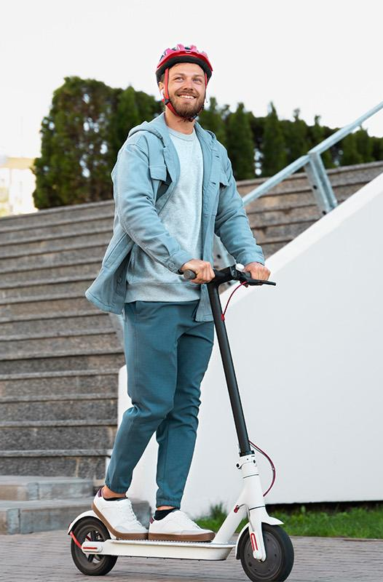
Thanks!
Please keep this slide for attribution

Slide 30
References
¹ Sandt, L., Harmon, K., 2019. “Dockless Electric Kick Scooter Systems: What we know and don’t know.” In: Presentation at the Transportation Research Board Annual Meeting. January 14, 2019.
² Walker, Kylie. .“Pittsburgh City Council Considering Traffic Regulations for E-Scooter Company”. September 8, 2021.

